Slide 1



Building Chrome extension with AngularJS
+
Ilija Tešić
Sarajevo Ruby Meetup, oktobar 2015

Slide 2
I will talk about…
AngularJS intro
Chrome extensions overview
Chrome extension architecture
Challenges in Chrome extension development
Where to start

Slide 3
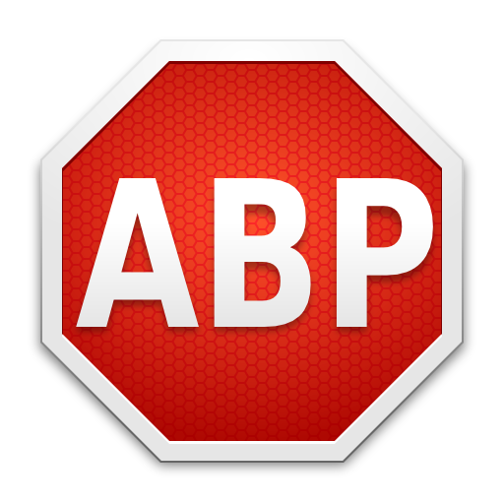
Adblock Plus

Slide 4
AngularJS
Powerful web framework
Modules
Directives
Dependency Injection

Slide 5
Simple Angular application
<html ng-app="myApp" >
<head >
<title>Simple Angular app</title>
</head>
<body ng-controller="mainController">
{{ pageContent }}
</body>
<script src="angular.js"></script>
</html>

Slide 6
Chrome extension overview
Types
Chrome API
Distribution

Slide 7
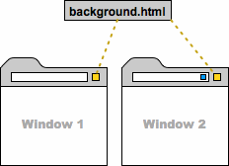
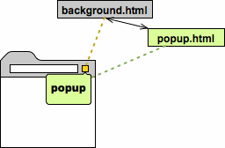
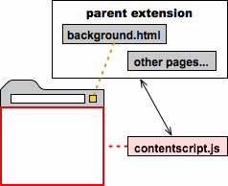
Chrome extension architecture
Background script
Popup script
Content script
Manifest
Messaging service

Slide 8
Challenges in Chrome extension development
How to put Angular(s) in Chrome extension architecture
Multiple scopes – communication between them
External link opens in iframe or new window / tab
OAuth is difficult to implement (other than Google API)
Notes:
Mine experience

Slide 9
Where to start
Developing Chrome extension: getting started tutorial https://developer.chrome.com/extensions/getstarted
Yeoman Chrome extension generator https://github.com/yeoman/generator-chrome-extension
AngularJS https://angularjs.org/

Slide 10
Thanks!
ilija@klika.ba – www.itesic.me – @itesic

